Slide 1
Modernizing Water Resource Management: FIRO at Lake Oroville
Evan Spanner | WR 440 Capstone Project | Colorado State University | Spring 2026
WATER RESOURCES ENGINEERING
CLIMATE ADAPTATION
RESERVOIR OPERATIONS
Notes:
Good morning. My name is Evan Spanner and this is my WR 440 capstone project on modernizing water resource management through forecast-informed reservoir operations at Lake Oroville, California.

Slide 2
Water Management Is Falling Behind
Water infrastructure across the U.S. operates on static rules designed decades ago — yet the hydrologic conditions those rules were built for have fundamentally changed.
Outdated Infrastructure
Atmospheric River Risk
Science-Practice Gap
Static operating rules govern systems now facing fundamentally different hydrologic conditions — rules that have not been meaningfully revised in over half a century.
Atmospheric rivers drive over 90% of flood damages in the western U.S. Their intensity is projected to increase significantly under continued climate change.
The forecasting tools to do better already exist. Yet the gap between available science and operational practice continues to widen with each passing season.
Notes:
Water infrastructure across the United States operates on static rules written decades ago. Oroville Dam, the tallest in the country, still runs under its 1970 Water Control Manual. The hydrology has changed, the forecast science has advanced by decades, and the operating rules have not kept pace. Atmospheric rivers cause over 90 percent of flood damages in the western United States, and their intensity is projected to increase under climate change. The tools to manage these events more effectively already exist. The gap is between available science and operational practice.

Slide 3
Research Question & Objectives
"What does effective water resource management look like in an era of increasing climate variability, and how can reservoir operating rules better serve that goal?"
01
02
Analyze Operations
Identify Optimal Levels
Examine existing reservoir inflow and outflow patterns at Lake Oroville across the historical record.
Determine storage and discharge levels that balance flood control, water supply, and aquifer recharge under variable climate conditions.
03
04
Compare Rule Sets
Infer Downstream Effects
Contrast downstream discharge before and after implementation of Forecast-Informed Reservoir Operations (FIRO).
Assess how forecast-informed operations affect flood risk, water availability, and consistency of regulated releases for downstream users.
Notes:
The research question driving this project is: what does effective water resource management look like in an era of increasing climate variability, and how can reservoir operating rules better serve that goal? The four objectives break that question into measurable pieces. First, analyze how the reservoir has actually operated under the existing rules. Second, identify storage and discharge levels that balance flood control, water supply, and aquifer recharge under variable climate conditions. Third, compare downstream discharge before and after FIRO implementation. Fourth, assess how forecast-informed operations would affect downstream users, including flood risk, water availability, and the consistency of regulated releases.

Slide 4

Lake Oroville & the Feather River
[Figure 1: Study Area Map]
Lake Oroville
Oroville Dam
Figure 1 — Map of Lake Oroville, Feather River Watershed, and downstream constraints including Yuba City / Marysville gauge location.
Largest reservoir in the California State Water Project
Tallest dam in the U.S. at 770 ft
Feather River Watershed
Downstream Constraint
3,607 sq mi drainage area
Channel capacity of 150,000 CFS at Yuba City / Marysville
Notes:
The Feather River watershed is in the northern Sierra Nevada of California, approximately 75 miles north of Sacramento. The Feather River is the largest tributary of the Sacramento River and a primary conveyance of the State Water Project. Lake Oroville is the largest reservoir in that system. Oroville Dam stands 770 feet tall, making it the tallest dam in the United States. The watershed drains 3,607 square miles into the reservoir. The critical downstream constraint is 150,000 cubic feet per second at Yuba City and Marysville. Exceeding that capacity puts those communities at flood risk. That 150,000 CFS threshold is the number this entire analysis revolves around.

Slide 5
The 1970 Water Control Manual
How the Current System Works
Critical Failures
The 1970 WCM uses a static guide curve based on a wetness index (WI = 3.5 to 11+). Maximum flood reservation reaches 750,000 AF at WI = 11 (elevation 848.5 ft). Release schedules are keyed to inflow magnitude with no forecast information incorporated. Rules have remained unchanged for 55+ years.
Cannot pre-release water ahead of forecasted storms
Reactive releases after flood pool is already filled
2017 spillway crisis: 188,000 evacuated when emergency spillway activated
Static rules cannot adapt to varying storm magnitudes
Notes:
The current operating rules date to 1970. They use a static guide curve tied to a wetness index that ranges from 3.5 to 11. The maximum flood reservation under the wettest conditions is 750,000 acre-feet at an elevation of 848.5 feet. Release decisions are keyed entirely to current inflow magnitude and how much flood control space has been used. No forecast information enters the decision. The rules are reactive. They cannot pre-release water ahead of a forecasted storm, and they cannot scale the response to match the predicted severity. The 2017 spillway crisis, which forced the evacuation of 188,000 people, demonstrated what happens when static rules meet a complex storm sequence.

Slide 6
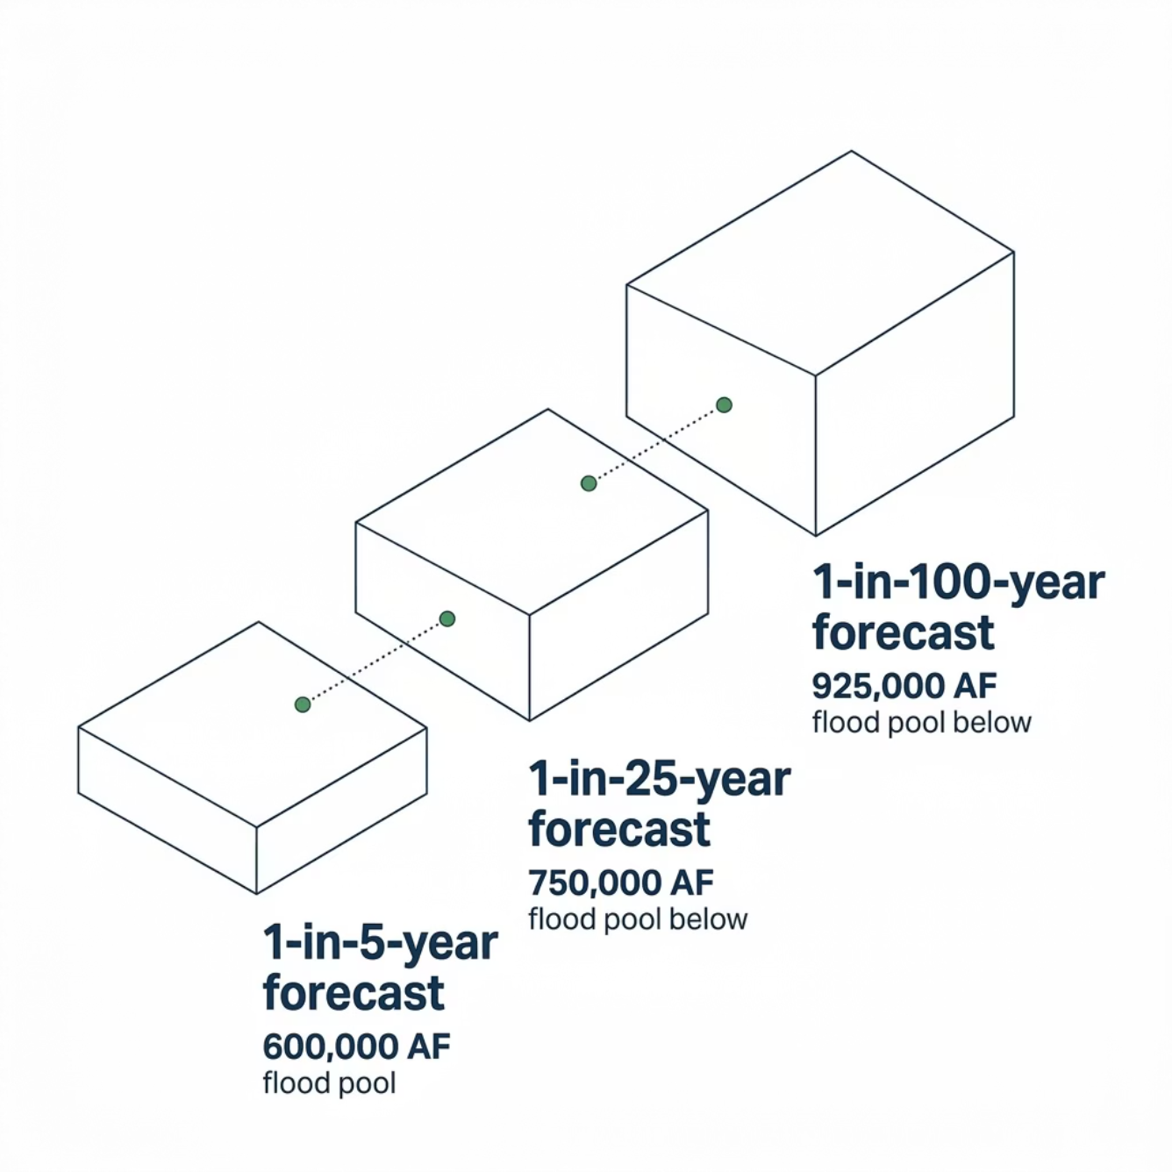


FIRO: Forecast-Informed Reservoir Operations
FIRO replaces static guide curves with dynamic, forecast-responsive flood pool management, using weather and streamflow forecasts to guide release decisions. Source: Yuba-Feather Final Viability Assessment (2025), ID3A rules developed specifically for Oroville.
Tiered Release Ceilings (CFS)
AEP Tier
Max Release
1-in-5 year
30,000 CFS
1-in-10 year
60,000 CFS
1-in-50 year
100,000 CFS
1-in-100 year
150,000 CFS
Key Mechanism: Pre-event drawdown creates flood storage space before the storm arrives.
Notes:
FIRO replaces the static guide curve with a dynamic, forecast-responsive flood pool. The methodology comes directly from the 2025 Yuba-Feather Final Viability Assessment, which developed these rules specifically for Oroville. The flood pool expands based on the annual exceedance probability of the forecasted inflow volume. A 1-in-5-year forecast triggers 600,000 acre-feet of flood space. A 1-in-25-year forecast triggers 750,000 acre-feet. A 1-in-100-year forecast triggers the maximum of 925,000 acre-feet. Release ceilings follow the same tiered structure: 30,000 CFS at the 1-in-5-year level, scaling up to the full 150,000 CFS design discharge only under the most extreme forecasts. The key mechanism is pre-event drawdown. The reservoir creates flood storage space before the storm arrives, keeping releases below channel capacity throughout the event.

Slide 7


February 1986 Atmospheric River Flood
Event: 20+ inches of rainfall over 11 days. Observed inflow peaked at 155,000 CFS.
[Figure 3: 1986 Event Hydrograph with AR Overlay]
Figure 3 — Observed and simulated inflow/outflow hydrographs for the February 1986 atmospheric river event under WCM and FIRO rule sets.
WCM Baseline
FIRO Alternative
Peak release: 100,000 CFS | Peak elevation: 861.4 ft
Peak release: 60,000 CFS — a 40.0% reduction | Peak elevation: 900.4 ft
Neither simulation triggered the emergency spillway.
Notes:
The February 1986 atmospheric river delivered more than 20 inches of rainfall to the upper Feather basin over 11 days. Observed inflow peaked at 155,000 CFS on February 18. The WCM simulation produced a peak release of 100,000 CFS, consistent with the 30,000 to 120,000 CFS inflow tier in the 1970 release schedule. The FIRO simulation produced a peak release of 60,000 CFS, a 40 percent reduction. This is the largest single-event improvement across the three case studies. Peak pool elevation rose from 861.4 feet under WCM to 900.4 feet under FIRO, placing the FIRO simulation within one foot of the 901-foot emergency spillway crest. Neither simulation triggered the emergency spillway, and both remained well below the 150,000 CFS downstream cap.

Slide 8
CASE STUDY 2
January 1997 New Year's Flood
[Figure 4: 1997 Event Hydrograph with AR Overlay]
The most severe event in the modern Oroville record. Full natural flow reached 317,234 CFS.
Figure 4 — Observed and simulated inflow/outflow hydrographs for the January 1997 New Year's flood under WCM and FIRO rule sets.
WCM Baseline
FIRO Alternative
Peak release: 150,000 CFS — full design discharge | Peak elevation: 892.5 ft
Peak release: 124,582 CFS — a 16.9% reduction | Peak elevation: 900.4 ft
FIRO kept downstream flow below the 150,000 CFS channel capacity threshold.
Notes:
The January 1997 New Year's flood is the most severe event in the modern Oroville record. A warm atmospheric river made landfall over northern California between December 26, 1996, and January 3, 1997. Full natural flow reached 317,234 CFS at the AR peak. The WCM simulation produced the full peak release of 150,000 CFS, the design discharge of the flood control outlet. The FIRO simulation held peak release to 124,582 CFS, a 16.9 percent reduction that kept downstream flow below the 150,000 CFS channel capacity at Yuba City. Peak pool elevation reached 892.5 feet under WCM and 900.4 feet under FIRO, both below the 901-foot emergency spillway crest. The FIRO simulation filled to its maximum storage capacity and used the full flood pool opened by the forecast-based operating envelope.

Slide 9

February 2017 Spillway Crisis
[Figure 5: 2017 Event Hydrograph with AR Overlay]
The Boundary Case. Spillway failure forced evacuation of 188,000 residents. Inflow arrived as two pulses separated by one week.
Figure 5 — Observed and simulated inflow/outflow hydrographs for the February 2017 spillway crisis under WCM and FIRO rule sets.
The 5-day forecast window could not fully resolve the multi-pulse storm sequence — neither triggered the emergency spillway, but FIRO reached its limits.
Both Simulations
Peaked at 100,000 CFS with zero net reduction. WCM: 882.4 ft | FIRO: 900.4 ft peak elevation.
Notes:
The February 2017 event caused the main spillway failure and the evacuation of 188,000 downstream residents. The inflow arrived as two pulses separated by a week rather than as a single sustained surge. Both simulations peaked at 100,000 CFS with zero net reduction. Peak elevation reached 882.4 feet under WCM and 900.4 feet under FIRO. Neither triggered the emergency spillway. This event marks the operational boundary of a 5-day forecast rule. Pulsed events give the forecast window less purchase because the system cannot fully resolve the second pulse before the first has passed. The simulator does not capture the structural spillway failure that drove the actual crisis; the pulsed character of the 2017 event and its implications for forecast-informed operations are the relevant finding here.

Slide 10

56-Year Simulation Results: 1971–2026
[Figure 6: Annual Peak Release Comparison]
Figure 6 — Annual peak release values under WCM and FIRO across the full 1971–2026 simulation period.
6→1
7→3
26.3%
Days ≥ 150K CFS
Years ≥ 100K CFS
Variability Reduction
WCM: 6 days | FIRO: 1 day at or above full channel capacity
WCM: 7 water years | FIRO: 3 with annual peaks at or above 100,000 CFS
Release std dev reduced from 11,482 to 8,463 CFS under FIRO
Notes:
Extending the comparison across the full 56-year record captures what individual events cannot. The 1970 WCM produced six days where releases reached or exceeded 150,000 CFS, clustered within the 1986, 1997, and 2017 floods. The FIRO alternative reduced that to one day. The WCM produced seven water years with annual peaks at or above 100,000 CFS. FIRO reduced that to three, and held each of those residual peaks at the release cap rather than above it. Release variability during the December through March flood season decreased 26.3 percent under FIRO, with the standard deviation of daily releases dropping from 11,482 CFS to 8,463 CFS.

Slide 11
Release Variability: WCM vs. FIRO
[Figure 7: Release Variability Comparison]
Why Smoother Releases Matter
The WCM's inflow-keyed schedule produces step changes at discrete thresholds (15,000 → 30,000 → 60,000 CFS) that propagate downstream as abrupt pulses.
Figure 7 — Time series comparison of regulated releases showing step-change behavior under WCM versus smooth progression under FIRO.
FIRO's forecast-based operation produces a smoother, more graduated release progression — reducing shock to the downstream system.
More stable winter releases support irrigation planning
Consistent regulated flow improves groundwater recharge
Notes:
This figure compares release patterns under the two rule sets. The WCM inflow-keyed schedule produces step changes at the 15,000, 30,000, and 60,000 CFS thresholds of the 1970 release table. Those step changes propagate to the downstream gauge as discrete pulses. The FIRO forecast-based operation produces a smoother release progression. More stable winter releases carry direct benefits for downstream users. Agricultural water users depend on predictable supply for irrigation scheduling, and managed aquifer recharge programs perform best under sustained moderate flows rather than sharp pulses.

Slide 12

Pool Elevation Trajectory: Water Year 2017
[Figure 8: Pool Elevation Trajectory]
Key Elevation Comparisons
Figure 8 — Lake Oroville pool elevation through WY 2017 under WCM (constant 848.5 ft target) and FIRO (dynamic drawdown to 835.0 ft under 1-in-100-yr forecast).
Event
WCM Peak
FIRO Peak
Feb 1986
861.4 ft
900.4 ft
Jan 1997
892.5 ft
900.4 ft
Feb 2017
882.4 ft
900.4 ft
Emergency spillway crest: 901.0 ft. FIRO peak elevations consistently within 1 ft — trading freeboard for significantly lower downstream releases.
Notes:
This figure compares pool elevation trajectories through water year 2017 under both rule sets. The WCM holds a constant target of 848.5 feet through the winter flood season regardless of forecast conditions. The FIRO rule targets 835.0 feet under a 1-in-100-year forecast, creating additional flood space when needed. Peak reservoir elevation under FIRO reached 900.4 feet in each of the three case-study events, roughly one foot below the 901-foot emergency spillway crest. The corresponding WCM peak elevations of 861.4 feet in 1986, 892.5 feet in 1997, and 882.4 feet in 2017 left more structural freeboard but produced the higher peak releases documented in the case studies.

Slide 13
What the Data Tells Us
Consistent Peak Reduction
Pre-Event Drawdown
FIRO reduced peak outflows across all simulated events and across the full 56-year period-of-record simulation.
Creating flood storage space before the storm arrives is the primary mechanism and the key operational advantage over static rules.
Downstream Protection
Scalable Benefits
Releases held within channel capacity in every case-study event. Smoother winter flows benefit agriculture and groundwater recharge.
Improvements in forecast skill translate directly into better flood outcomes — the system improves as the science improves.
Notes:
Four findings summarize the results. First, FIRO consistently reduces peak outflows across all simulated events and the full period of record. Second, pre-event drawdown is the primary mechanism. Creating flood storage space before the storm arrives is the key operational advantage. Third, downstream communities experience releases held within channel capacity during every case-study event, and a more stable winter flow regime supports agriculture and groundwater recharge. The FVA documents 175,000 acre-feet of additional water supply storage at Oroville under operational FIRO. Fourth, benefits scale with forecast skill and event magnitude, meaning improvements in forecasting translate directly to better flood outcomes.

Slide 14

Limitations & The Broader Imperative
Study Limitations
The Broader Imperative
Oroville at-site rules only; full coordinated Yuba-Feather system would likely show larger benefits
Simplified mass-balance simulation with perfect foresight — peak reductions represent an upper bound
Operational FIRO would use ID4A ensemble rules with comparable performance under realistic forecast error
The era of static water resource management is ending. Oroville's WCM update — initiated by USACE in 2024 — is the mechanism to translate these findings into practice.
The same process applies to ~750 USACE-operated dams nationwide operating under similarly outdated frameworks.
The concrete and steel do not need to change. The rules do — and the tools to write better rules already exist.
Notes:
This analysis uses Oroville's at-site rules only. The full coordinated Yuba-Feather system operations would likely show larger benefits. The simulation uses a simplified mass-balance approach with perfect foresight rather than real ensemble forecasts. These simplifications set an upper bound on peak reduction. Operational FIRO would use the ID4A ensemble rule set, and the FVA reports comparable performance under realistic forecast error. The elimination of nearly all days above 150,000 CFS is the finding most resistant to forecast uncertainty because it follows from capping releases at forecast-determined thresholds rather than from predicting any specific inflow volume. Oroville's Water Control Manual update, formally initiated by USACE in 2024, is the mechanism that will translate these findings into practice. The same process applies to the roughly 750 USACE-operated dams nationwide running under similarly outdated frameworks. The concrete and steel of the dams do not need to change. The rules that govern how we run them do, and the tools to write better rules already exist.

