Slide 1
Modernizing Water Resource Management: FIRO at Lake Oroville
Evan Spanner | WR 440 Capstone Project | Colorado State University | Spring 2026
FORECAST-INFORMED RESERVOIR OPERATIONS
CLIMATE ADAPTATION
CALIFORNIA WATER POLICY

Slide 2
THE PROBLEM
Static Rules in a Changing Climate
Outdated Infrastructure
Atmospheric River Risk
Science-Practice Gap
Static rules govern systems facing fundamentally different conditions today
ARs cause over 90% of flood damages in the western U.S. — and are projected to intensify
Better tools already exist. The gap between science and operational practice keeps widening

Slide 3
RESEARCH QUESTION
Can Reservoir Rules Keep Pace with Climate?
"What does effective water resource management look like in an era of increasing climate variability, and how can reservoir operating rules better serve that goal?"
01
02
Analyze Operations
Identify Optimal Thresholds
Existing reservoir inflow and outflow patterns
Balance flood control, water supply, and aquifer recharge
03
04
Compare Scenarios
Infer Downstream Impacts
Downstream discharge — before and after FIRO
Effects on downstream users under forecast-informed operations

Slide 4

STUDY AREA
Lake Oroville & the Feather River Watershed
[Figure 1 — Study Area Map]
Lake Oroville
Oroville Dam
Insert Fig 1 here: Watershed map showing Lake Oroville, Feather River, and Yuba City / Marysville downstream constraint point.
Largest reservoir in the CA State Water Project
Tallest dam in the U.S. — 770 ft
Feather River Watershed
Downstream Constraint
3,607 sq mi drainage area
150,000 CFS channel capacity at Yuba City / Marysville

Slide 5

HISTORICAL OPERATIONS
56 Years of High-Flow Events
[Figure 2 — Event Timeline]
Insert Fig 2 here: Timeline of 44 high-flow events (1970–2026) highlighting 1986, 1997, and 2017 major floods.
56
44
3
Year Record
High-Flow Events
Major Floods
1970 – 2026
Exceeding 15,000 CFS threshold
1986 · 1997 · 2017

Slide 6

CURRENT RULES
The 1970 Water Control Manual
What It Does
What It Cannot Do
Static guide curve tied to wetness index (WI 3.5 – 11+)
Max flood reservation: 750,000 AF at WI = 11 (elev. 848.5 ft)
Release schedule keyed to inflow magnitude only
Pre-release ahead of incoming storms
Scale response to predicted severity
Incorporate any forecast information
Unchanged for 55+ years — no forecast input by design

Slide 7




THE SOLUTION
Forecast-Informed Reservoir Operations (FIRO)
FIRO replaces static rules with forecast-responsive flood pool management — using weather intelligence to make smarter release decisions before storms arrive.
Dynamic Flood Pool
Tiered Release Ceilings
Pre-Event Drawdown
600K AF (1-in-5 yr) → 750K AF (1-in-25 yr) → 925K AF (1-in-100 yr)
30K → 60K → 100K → 150K CFS scaled by Annual Exceedance Probability
Key mechanism — create storage before the storm, not during it
Precedent: Lake Mendocino FIRO implemented 2020 · Rules source: Yuba-Feather FVA (2025)

Slide 8
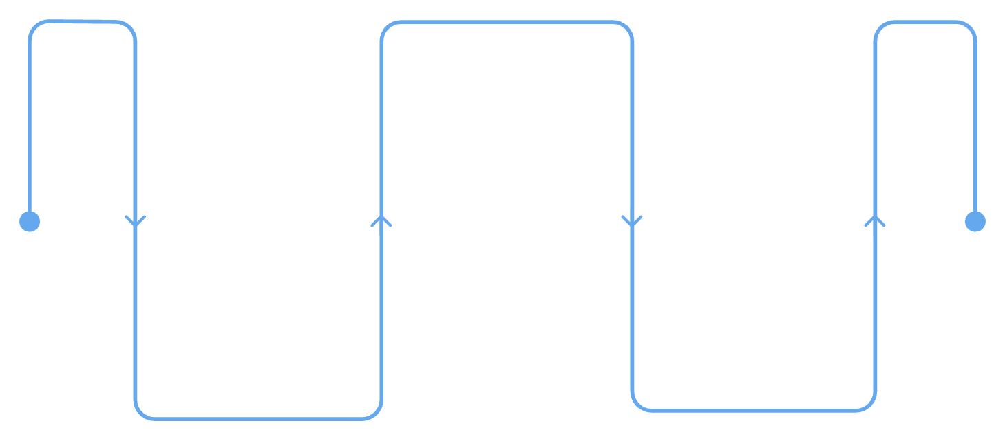
METHODS
Simulation Framework
Two Scenarios — Same Inputs
Baseline
FIRO Alternative
Run Scenarios
Baseline WCM vs FIRO ID3A with identical inflows
1970 WCM rules applied mechanically across full record
ID3A prescriptive rules from the Yuba-Feather FVA (2025)
Build Simulator
Compare Results
Daily mass-balance Python model, 56-year record
Three case events and full period-of-record analysis
Perfect-foresight forecast used — represents upper bound on FIRO performance

Slide 9
CASE STUDY 1
February 1986
[Figure 3 — 1986 Event Hydrograph with AR Overlay]
WCM Peak Release
FIRO Peak Release
Insert Fig 3 here: Hydrograph comparing WCM vs. FIRO outflows during Feb 1986 atmospheric river event.
100,000 CFS
60,000 CFS — 40% reduction
Peak Elevation
861.4 ft (WCM) vs 900.4 ft (FIRO)

Slide 10
CASE STUDY 2
January 1997 — Most Severe on Record
[Figure 4 — 1997 Event Hydrograph with AR Overlay]
Full Natural Flow
WCM Peak Release
Insert Fig 4 here: Hydrograph comparing WCM vs. FIRO outflows during Jan 1997 event (317,234 CFS full natural flow).
317,234 CFS — record inflow
150,000 CFS — full design discharge
FIRO Peak Release
124,582 CFS — 16.9% reduction, stayed within channel capacity

Slide 11
CASE STUDY 3
February 2017 — The Boundary Case
[Figure 5 — 2017 Event Hydrograph with AR Overlay]
Key Findings
Spillway failure — 188,000 evacuated
Both scenarios peaked at 100,000 CFS — zero net reduction
Two storm pulses separated by one week limited forecast advantage
Insert Fig 5 here: Hydrograph for Feb 2017 showing dual-pulse storm pattern and 100,000 CFS peak for both scenarios.
Boundary case for a 5-day forecast rule — FIRO cannot overcome all storm patterns

Slide 12

PERIOD-OF-RECORD RESULTS
56-Year Performance Comparison
[Figure 6 — Annual Peak Release Comparison]
Insert Fig 6 here: Annual peak release scatter/bar chart comparing WCM vs. FIRO across all 56 water years.
83%
57%
Reduction in Days ≥ 150K CFS
Fewer Years ≥ 100K CFS Peak
WCM: 6 days → FIRO: 1 day
WCM: 7 years → FIRO: 3 years
56-yr record peak: 274,267 CFS (WCM) vs 150,000 CFS (FIRO)

Slide 13
RELEASE VARIABILITY
Smoother, More Predictable Releases
[Figure 7 — Release Variability Comparison]
Insert Fig 7 here: Time series or box plots showing winter release variability for WCM vs. FIRO.
Winter Release Std Dev
26%
Variability Reduction
11,482 CFS (WCM) → 8,463 CFS (FIRO)
WCM produces abrupt step changes at inflow thresholds. FIRO produces smoother, graduated releases — benefiting irrigation planning and groundwater recharge.

Slide 14

FLOOD POOL UTILIZATION
Dynamic vs. Static Pool Management
[Figure 8 — Pool Elevation Trajectory]
WCM Target
Insert Fig 8 here: Reservoir elevation trace comparing WCM fixed target (848.5 ft) vs. FIRO dynamic drawdown during case study events.
Constant 848.5 ft regardless of forecast conditions
FIRO Target
Dynamic — down to 835.0 ft under extreme forecasts
FIRO Peak Elevation
900.4 ft across all three case studies — within 1 ft of emergency spillway

Slide 15

KEY FINDINGS
What the Data Show
Consistent Peak Reduction
Pre-Event Drawdown Works
FIRO reduced peak outflows across all events and the full 56-year record
Creating storage before the storm is the primary performance mechanism
Safer Downstream Flows
Benefits Scale with Forecast Skill
Releases held within channel capacity; winter flows more stable and predictable
As forecast science improves, FIRO performance improves with it

Slide 16

CONCLUSION
The Rules Need to Change — The Tools Already Exist
Limitations
The Core Argument
At-site Oroville rules only — full system integration would yield larger benefits
Perfect foresight sets an upper bound; operational ID4A shows comparable results
Decades-old static rules were designed for a climate that no longer exists. FIRO provides a scientifically grounded, operationally proven framework to close the gap between what we know and how we operate.
The science is ready. The policy window is open. Implementation is the next step.
What Comes Next
Oroville WCM update initiated by USACE in 2024
Same process applicable to ~750 USACE dams nationwide

